Slide 1

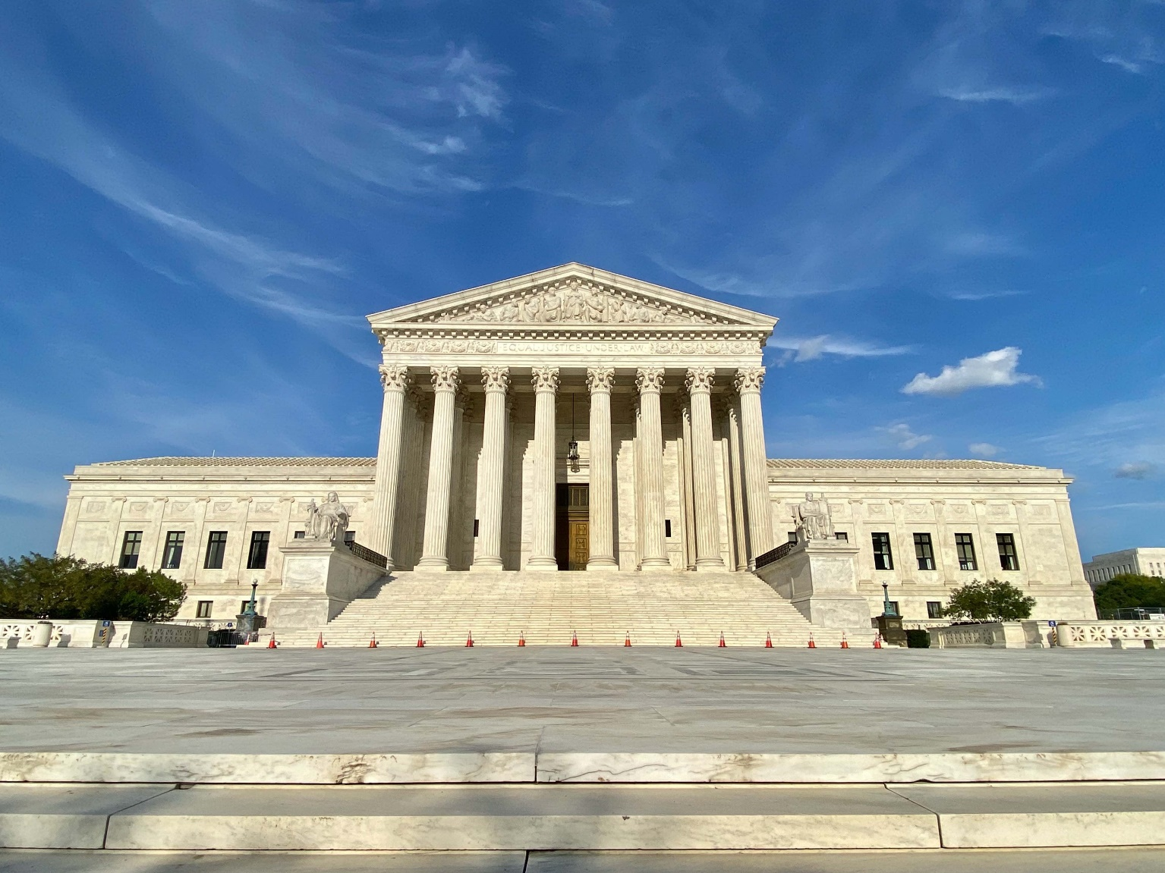
Final Stat Pack for the 2024-25 term Updated July 2, 2025
Compiled by Jake S. Truscott (Ph.D.) & Adam Feldman (J.D., Ph.D.)
Visit: www.scotusblog.com Follow: @scotusblog Email: scotusblog@thedispatch.com

Slide 2
TABLE OF CONTENTS
Introduction …………………………………………………………………………………………………………………………………………………………………………………………………………… | 3
Opinions Over Time ………………………………………………………………………………………………………………………………………………………………………………………………. | 4
Makeup of the Opinions of the Court ………….………………………………………………………………………………………………………………………………………………………… | 5-6
Unanimity ……………………………………………………………………………………………………………………………………………………………………………………………………………… | 7
Frequency in the Majority (All Cases, Non-Unanimous Cases, and Closely Divided Cases) ……………………………………………………………………………………. | 8-10
Justice Agreement (All Cases vs. Closely Divided Cases) ………………………………………………………………………………………………………………………………………… | 11-12
Strength of the Majority ………………………………………………………………………………………………………………………………………………………………………………………… | 13
Closely Divided Cases ………………………………..………………………………………………………………………………………………………………………………………………………….. | 14
Decisions by Vote Split (All Cases vs. Ideologically Split Cases) ………………………………………………………………………………………………………………………………. | 15-16
Circuits Scorecard …………………………………..……………………………………………………………………………………………………………………………………………………………… | 17
Days Between Oral Argument & Opinion ………………………………………………………………………………………………………………………………………………………………. | 18
Opinions Authored by Each Justice ………………………………………………………………………………………………………………………………………………………………………… | 19-21
Opinion Lengths …………………………………………………………………………………………………………………………………………………………………………………………………….. | 22
Voting Alignments …………………………………………………………………………………………………………………………………………………………………………………………………. | 24-28
Term Index …………………………………………………………………………………………………………………………………………………………………………………………………………….. | 29

Slide 3
INTRODUCTION
Key Findings in the Stat Pack for the 2024-25 Term
Steady Decline of Unanimity. 42% of cases were decided unanimously this term – compared to 44% in the previous term and 50% in the 2022-23 term. 6-3 Decisions. Ten decisions or 15% of decided cases were by 6-3 split votes.
Ideological Splits in Closely Divided Cases. The Court divided 6-3 with Justices Sotomayor, Kagan, and Jackson dissenting in 9% of the opinions and with Justices Thomas, Alito, Gorsuch dissenting in 6% of the opinions. Including 5-4 opinions, all three of the Court's liberal justices were together in dissent in 15% of the cases. Decisions with three or more conservative justices in dissent made up 15% of cases as well and decisions with only conservative justices in the dissent made up 28% of the cases. Roberts at the Helm. Chief Justice John Roberts was in the majority most frequently at 95% in all cases, 92% in non-unanimous cases, and 90% in closely divided cases, and he did not write a single separate opinion this term. Justice Kavanaugh was in the majority second most frequently in all cases at 92%, followed by Justice Barrett at 89%. Liberals Gaining Ground. Justice Kagan was in the majority 83% of the time in all cases this term – which was more common than Justices Thomas, Gorsuch, and Alito, who were each in the majority 78% of the time. Justice Sotomayor was also in the majority 78% of the time. Top Alignments at the Poles. The top alignment in all cases was between Justices Alito and Thomas at 97% of the time, while Justices Jackson and Sotomayor are next at 94%. Chief Justice Roberts and Justice Kavanaugh – who have aligned together more than any other justice pair in previous terms – aligned 91% of the time.
Circuit Cases and Reversals. Cases from the First, Fourth, Ninth, and Tenth Circuits were reversed 100% of the time. The Fifth Circuit had the most total cases reversed, with ten, though three were affirmed—resulting in a 77% reversal rate. This term was unusual in that the Ninth Circuit, which is typically the most reviewed, had fewer than one-third as many cases decided as the Fifth Circuit. Even the Fourth Circuit had twice as many cases decided—eight compared to the Ninth Circuit's four.

Slide 4
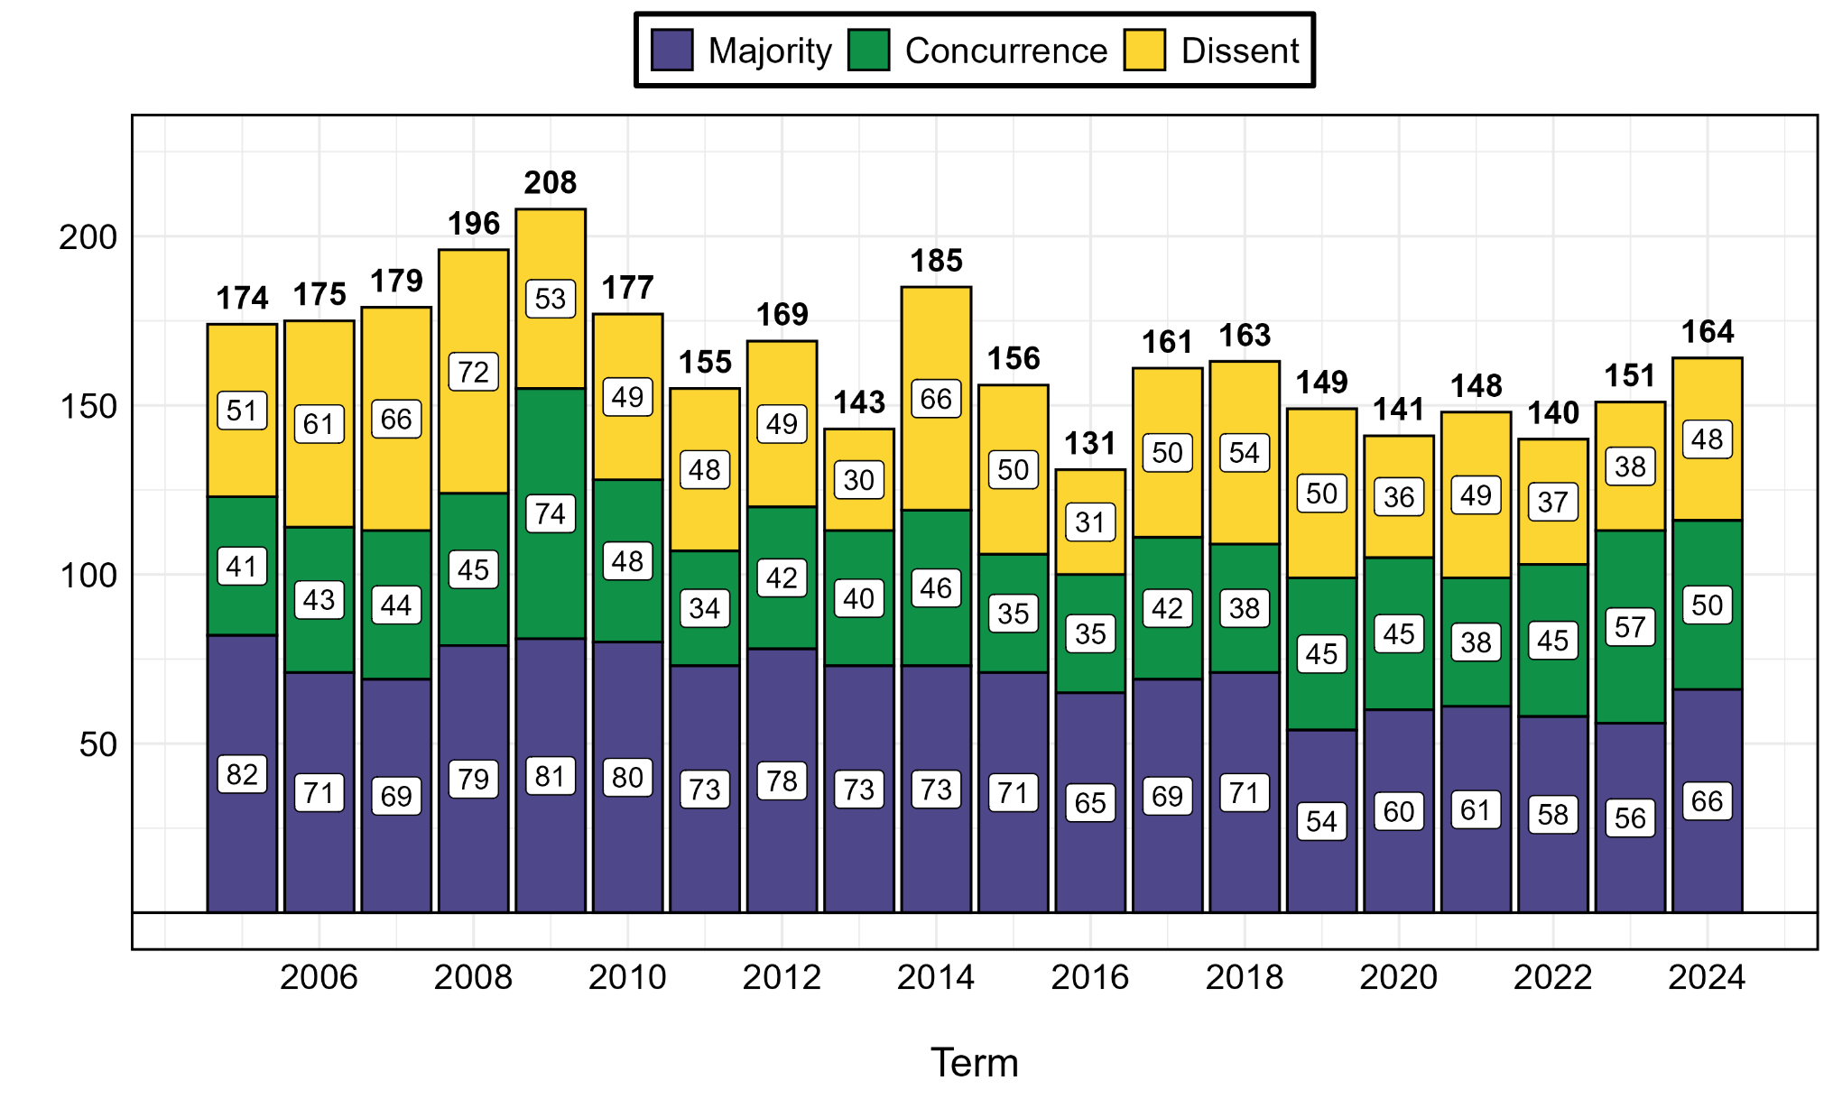
TOTAL OPINIONS OVER TIME
Please note that the Stat Pack only focuses on “Opinions of the Court” and not "Opinions Relating to Orders," the latter of which includes several of the cases on the so-called emergency/shadow docket
Figure shows the volume & proportion of opinions (by type) authored by the court between the 2005 and 2024 terms. Data from earlier terms were retrieved from the Supreme Court Database. Opinions delivered per curiam are coded as a majority opinion, while special concurrences (in part) and those concurring in judgment are both coded as concurrences.

Slide 5
Please note that we do not include Goldey v. Fields, which reversed and remanded the judgment of the U.S. Court of Appeals for the 4th Circuit on June 30, 2025 – after the term had already concluded
MAKEUP OF THE OPINIONS OF THE COURT
Case Name | Abbreviation | Issue Summary
A.A.R.P. v. Trump | A.A.R.P v. Trump | Immigration removal and procedural due process
A.J.T. v. Osseo Area Schools | A.J.T | Disability discrimination standard in education
Advocate Christ Medical Center v. Kennedy | Advocate Christ Medical | Medicare eligibility based on SSI payment month
Ames v. Ohio Department of Youth Services | Ames | Discrimination claim standard for majority-group employee
Andrew v. White | Andrew | Due process and prejudicial evidence in capital trial
Barnes v. Felix | Barnes | Excessive force standard under Fourth Amendment
BLOM Bank SAL v. Honickman | BLOM Bank | Standard for reopening cases under Rule 60(b)(6)
Bondi v. Vanderstok | Vanderstok | ATF regulation of ghost guns
Bouarfa v. Mayorkas | Bouarfa | Judicial review of visa revocation for sham marriage
Bufkin v. McDonough | Bufkin | Clear-error review of VA benefit decisions
Catholic Charities Bureau v. Wisconsin LIRC | Catholic Charities | Religious exemption denial under First Amendment
CC/Devas v. Antrix | CC/Devas | Jurisdiction over foreign states under FSIA
City and County of SF v. EPA | SF v. EPA | EPA Clean Water Act authority on water permits
Commissioner of IRS v. Zuch | Zuch | IRS levy challenge mootness
Cunningham v. Cornell University | Cunningham | ERISA fiduciary transaction pleading
Delligatti v. United States | Delligatti | Force element in omission-based crimes
Department of Education v. California | DOE v. CA | Education grants, APA challenge, and agency funding authority
Dewberry Group v. Dewberry Engineers | Dewberry | Lanham Act profits limited to named defendant
Diamond Alternative Energy v. EPA | Diamond | Standing based on third-party regulatory impact
E.M.D. Sales v. Carrera | E.M.D. Sales | FLSA exemption proof standard
EPA v. Calumet Shreveport | Calumet | Venue for refinery exemption claims under CAA
Esteras v. United States | Esteras | Sentencing factor use in supervised release revocation
Facebook v. Amalgamated Bank | Facebook | Materiality of past risks in securities filings
FDA v. Wages and White Lion | Wages and White Lion | FDA denial of e-cigarette marketing applications
FCC v. Consumers’ Research | Consumers’ Research | Constitutional limits on FCC funding authority
Feliciano v. DOT | Feliciano | Differential pay for emergency military service
FDA v. R.J. Reynolds | R.J. Reynolds | Proper venue in agency review cases
Free Speech Coalition v. Paxton | Free Speech | Review standard for adult-content web restrictions
Fuld v. Palestine Liberation Organization | Fuld | Due process challenge to terrorism liability statute
Glossip v. Oklahoma | Glossip | Due process violation for false trial testimony
Gutierrez v. Saenz | Gutierrez | Access to DNA testing under Texas law
Hamm v. Smith | Hamm | Death penalty eligibility and intellectual disability
Hewitt v. United States | Hewitt | Application of First Step Act to resentencing
Kennedy v. Braidwood Management | Kennedy | Appointments Clause challenge to health agency

Slide 6
MAKEUP OF THE OPINIONS OF THE COURT (Cont.)
Case Name | Abbreviation | Issue Summary
Kousisis v. United States | Kousisis | Wire fraud liability without economic loss
Laboratory Corp. v. Davis | Laboratory Corp. | Standing for class members in Rule 23(b)(3) cases
Lackey v. Stinnie | Lackey | Attorney’s fees after preliminary injunction
Louisiana v. Callais | Louisiana | VRA and constitutionality of majority-Black district
Mahmoud v. Taylor | Mahmoud | Parental rights in gender and sexuality instruction
Martin v. United States | Martin | FTCA limits and discretionary function exception
McLaughlin Chiropractic v. McKesson | McLaughlin | Deference to FCC under Hobbs Act
Medical Marijuana v. Horn | Medical Marijuana | RICO damages for injury-linked property loss
Medina v. Planned Parenthood | Medina | Medicaid right to choose provider
Monsalvo Velazquez v. Garland | Velazquez | Immigration deadline rule for voluntary departure
NRC v. Texas | NRC | Challenge to nuclear waste storage and review rights
NVIDIA v. Ohman | NVIDIA | Pleading standards for securities fraud intent
Oklahoma Charter Board v. Drummond | Drummond | Religious access to charter school system
Oklahoma v. EPA | Oklahoma | Jurisdiction for state-specific EPA rules
Parrish v. United States | Parrish | Appeal procedure after time-to-appeal reopened
Perttu v. Richards | Perttu | Jury trial on PLRA exhaustion disputes
Republic of Hungary v. Simon | Hungary | Commercial activity requirement under FSIA
Riley v. Bondi | Riley | Immigration appeal deadline jurisdiction
Rivers v. Guerrero | Rivers | Limits on second habeas petitions
Royal Canin v. Wullschleger | Royal Canin | Federal jurisdiction over amended complaints
Seven County v. Eagle County | Seven County | NEPA scope for indirect environmental effects
Smith & Wesson v. Mexico | Smith and Wesson | Gunmaker immunity in foreign violence claims
Soto v. United States | Soto | Retroactive pay under CRSC and Barring Act
Stanley v. City of Sanford | Stanley | ADA protection for post-employment benefits
Thompson v. United States | Thompson | Misleading vs. false statements under § 1014
TikTok v. Garland | TikTok | First Amendment challenge to TikTok restrictions
Trump v. CASA | Trump v. CASA | Nationwide injunction scope in constitutional cases
Trump v. J.G.G. | Trump v. J.G.G. | Alien detention and habeas under wartime authority
United States v. Miller | Miller | Bankruptcy clawback and sovereign immunity
United States v. Skrmetti | Skrmetti | Transgender care ban for minors
Waetzig v. Halliburton | Waetzig | Dismissals under Rule 41 as final for Rule 60
Williams v. Reed | Willaims | Exhaustion rule and Section 1983 state suits
Wisconsin Bell v. U.S., ex rel. Health | Wisconsin Bell | False Claims Act coverage of telecon reimbursements

Slide 7
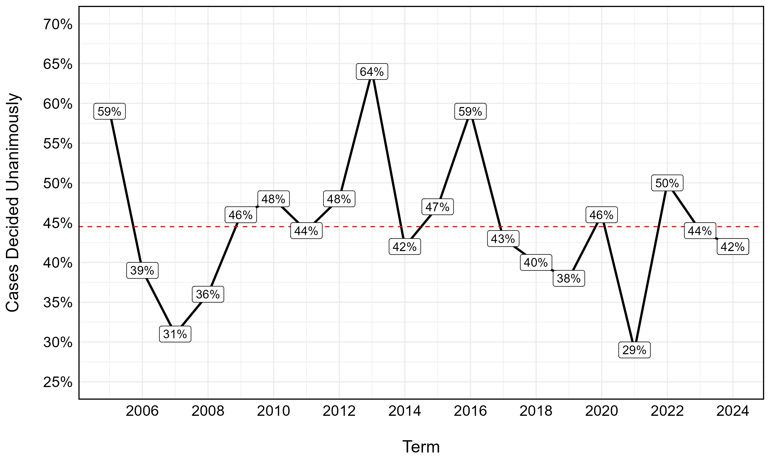
UNANIMOUS DECISIONS
This figure shows the percentage of unanimous decisions (i.e., cases decided without any full dissents) between OT05-OT24. These include decisions reached per curiam without any noted dissents. Dashed red line represent longitudinal average (44.5%).

Slide 8
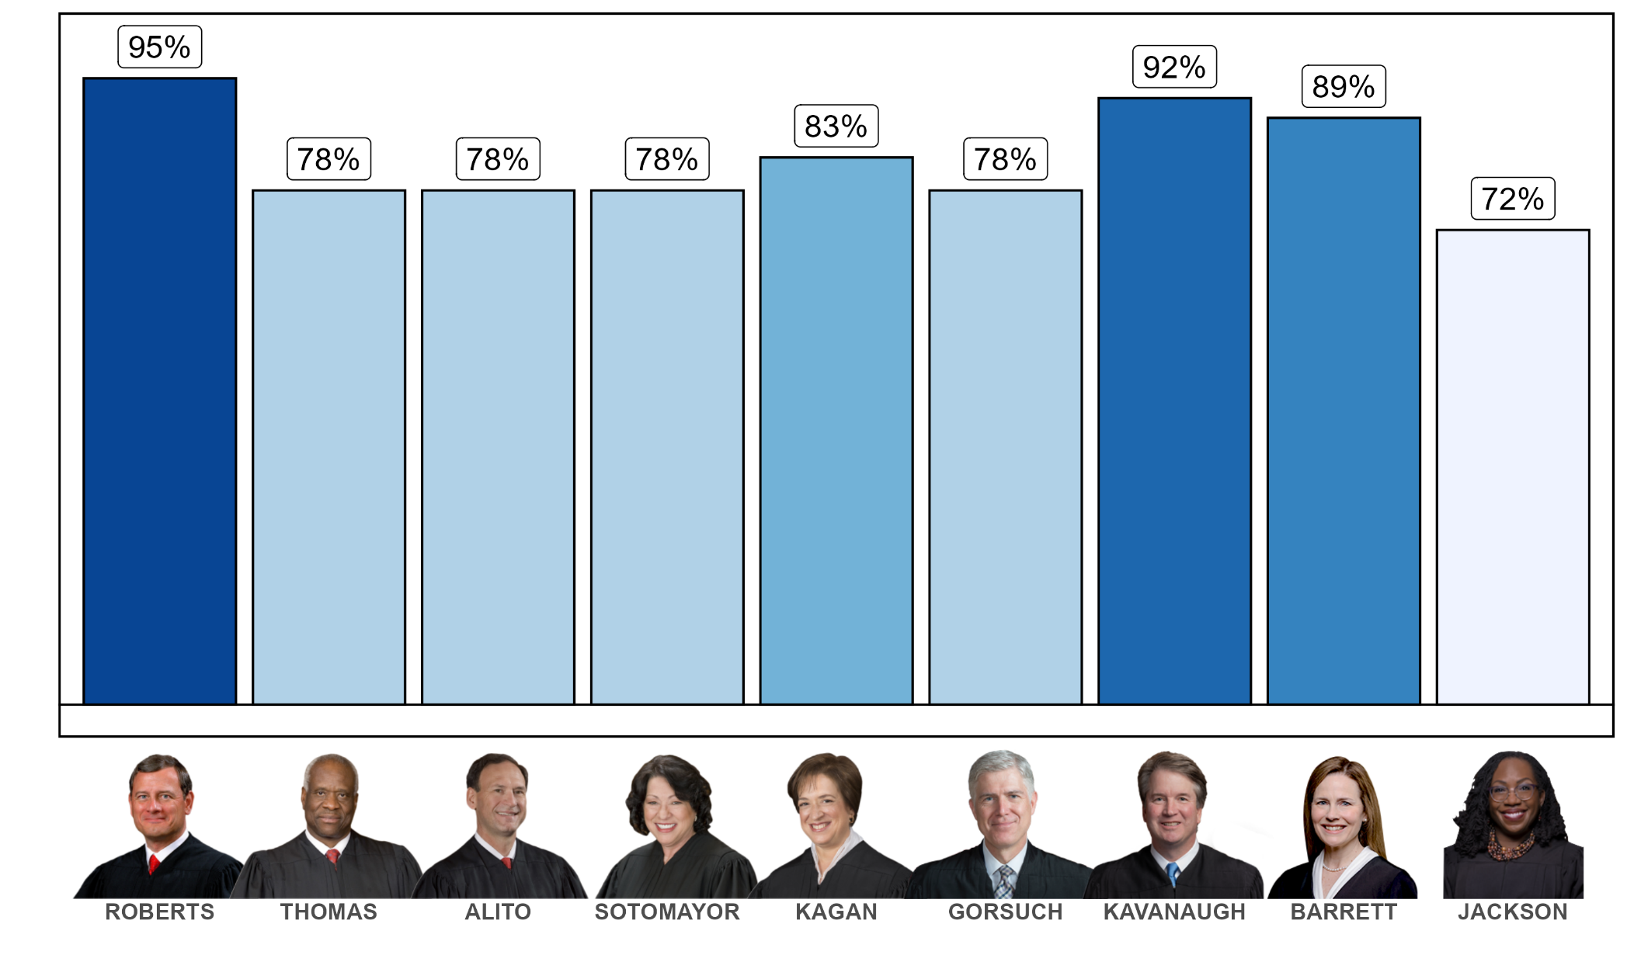
FREQUENCY IN THE MAJORITY – All Cases
Figure shows the percentage of cases where each justice was in the majority coalition among all cases that they participated in (including those decided unanimously, per curiam, or dismissed as improvidently granted). Note: Given that majority and dissenting votes were not indicated, these percentages do not include any votes from the court’s equally divided decision in Drummond.

Slide 9
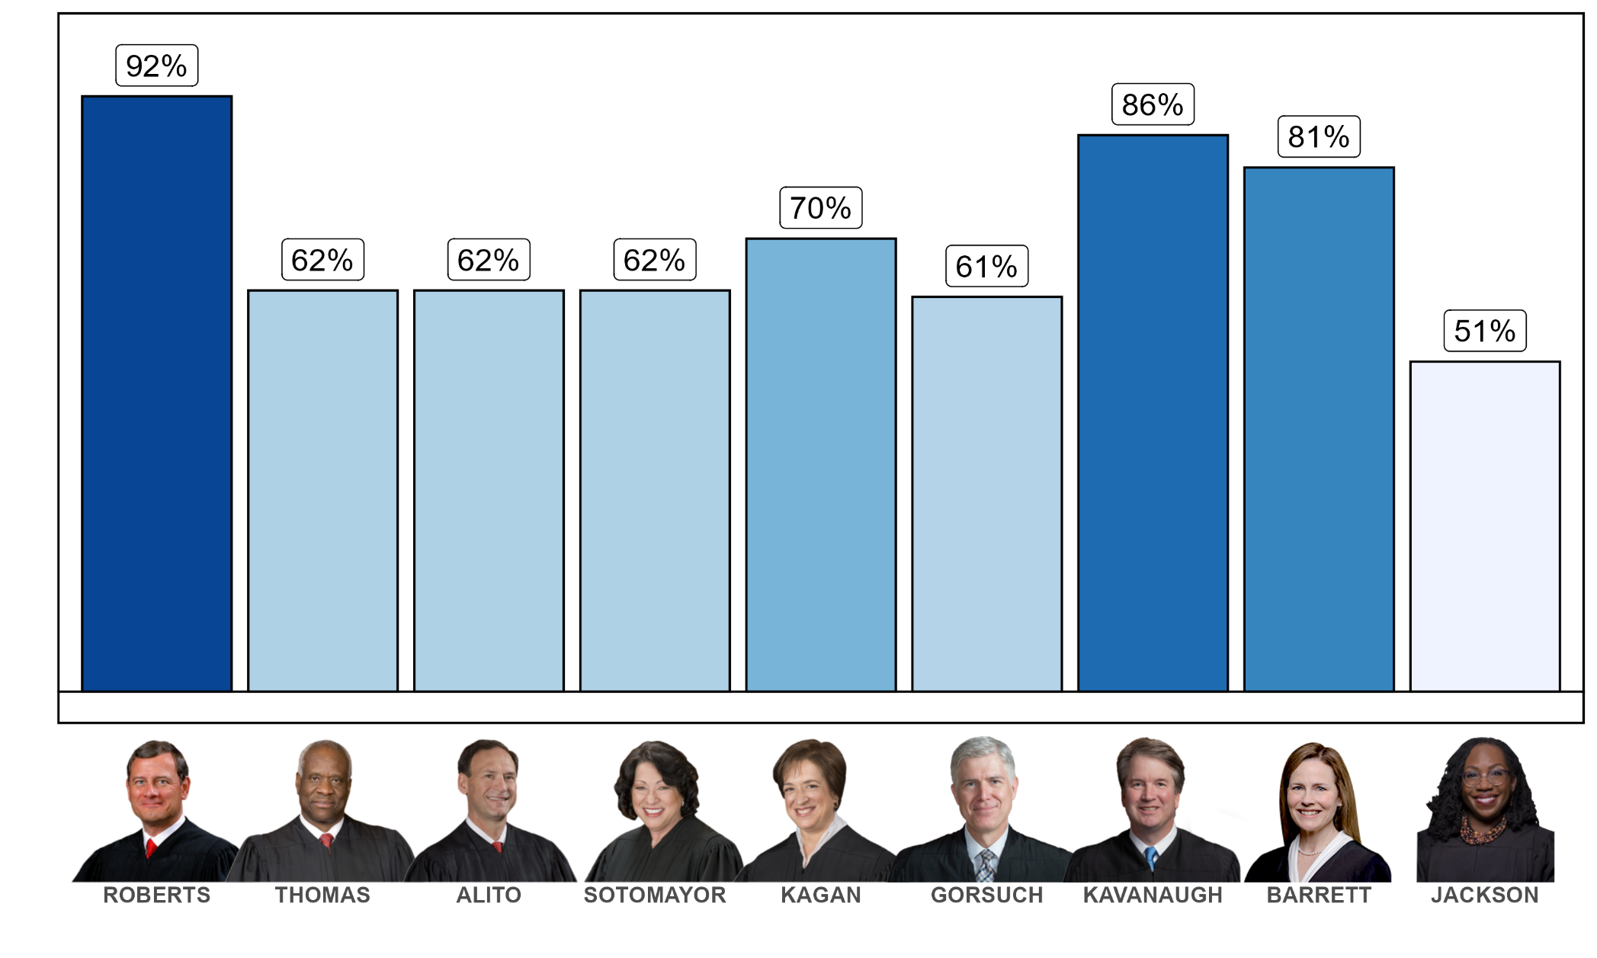
FREQUENCY IN THE MAJORITY – Non-Unanimous Cases
Figure shows the percentage of cases where each justice was in the majority coalition among cases decided without a unanimous majority.

Slide 10
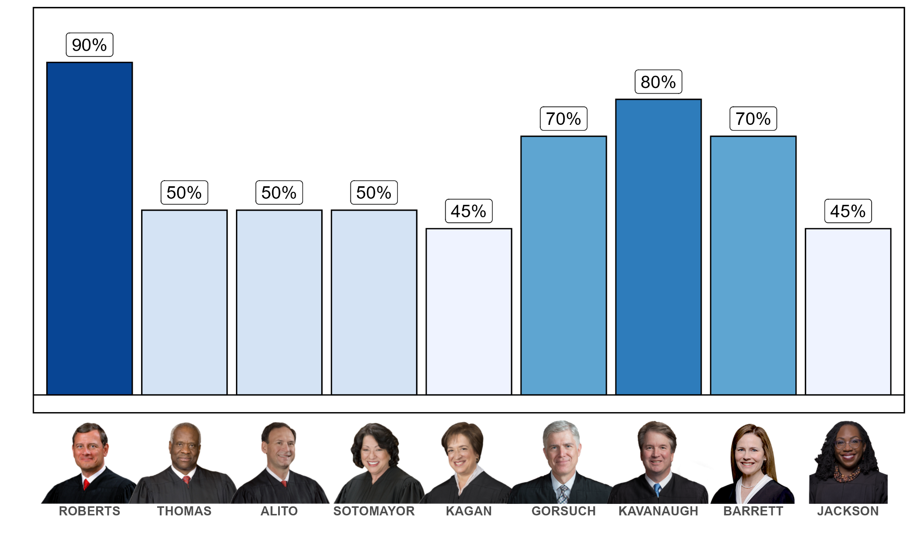
FREQUENCY IN THE MAJORITY – Closely Divided Cases
Figures show the percentage of cases where each justice was in the majority coalition among cases decided by (5-4) or (6-3) coalitions.

Slide 11
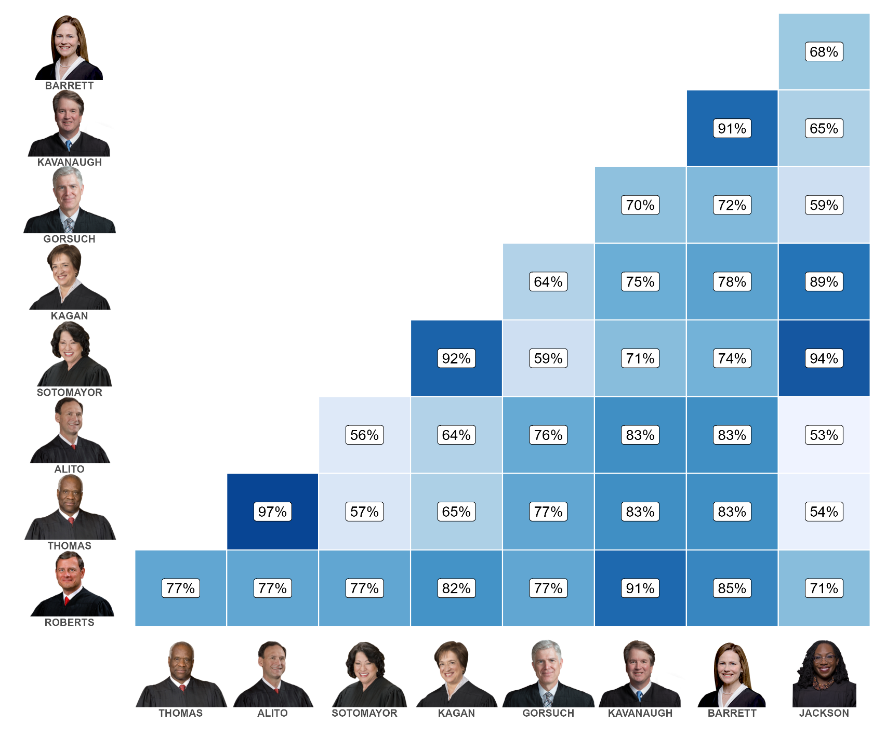
JUSTICE AGREEMENT – All Cases
Figure shows the relative agreement (percent) in voting alignment shared between justices in all cases where justices participated during the 2024 term.
Agreement can be understood as justices similarly aligning in the majority (or dissenting) coalition – where those who concur (fully, in part, or in judgment) are similarly considered as part of the majority.

Slide 12
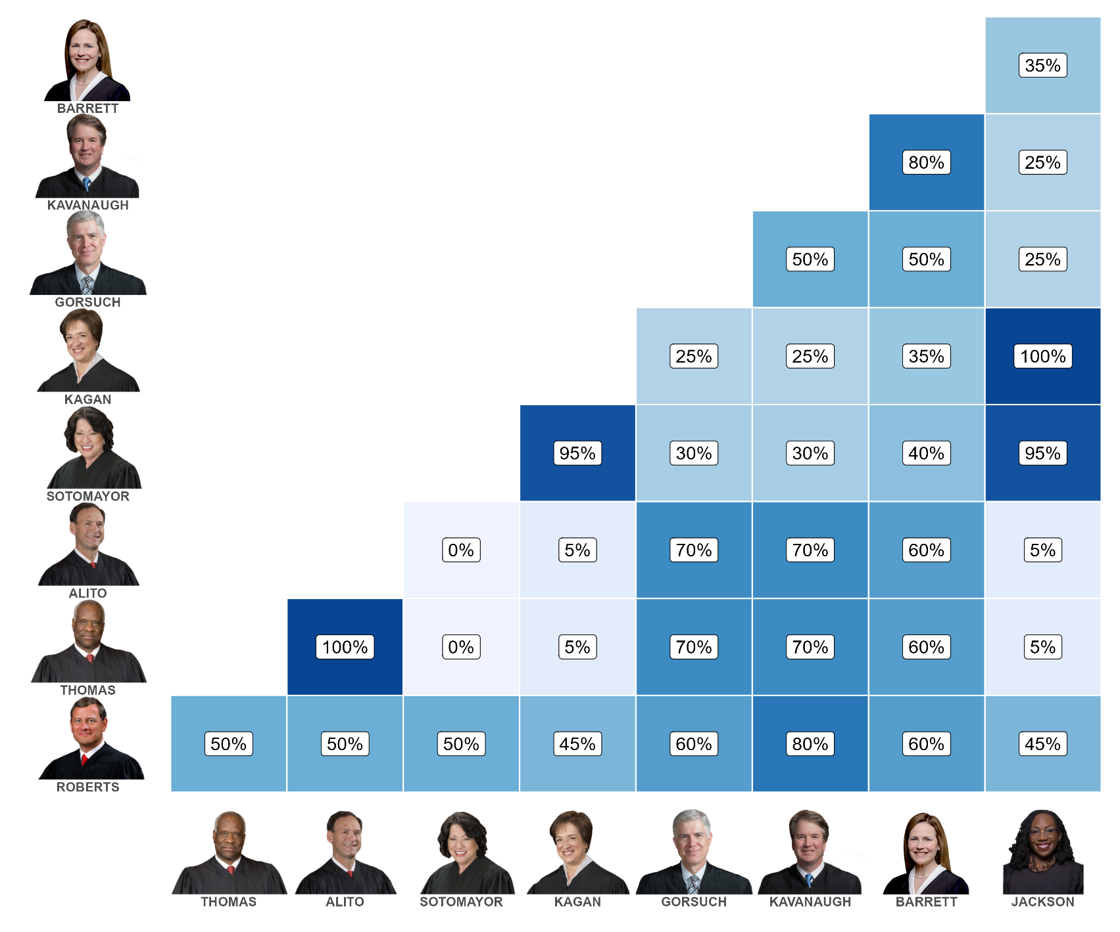
JUSTICE AGREEMENT – Closely Divided Cases
Figure shows the relative agreement (percent) in voting alignment shared between justices in cases decided by (5-4) or (6-3) coalitions where justices participated during the 2024 term.
Agreement can be understood as justices similarly aligning in the majority (or dissenting) coalition – where those who concur (fully, in part, or in judgment) are similarly considered as part of the majority.

Slide 13
STRENGTH OF THE MAJORITY
Only cases with a signed majority opinion are included in this analysis – cases decided per curiam with no signed majority opinion are omitted. Glossip is included here as a (6-3) opinion.
 | Total opinions | Unanimous opinions | 8-1 opinions | 7-2 opinions | 6-3 opinions | 5-4 opinions | Average majority
Roberts | 6 | 3 | 0 | 1 | 1 | 1 | 7.5
Thomas | 7 | 3 | 0 | 3 | 1 | 0 | 7.71
Alito | 6 | 3 | 0 | 0 | 1 | 2 | 7.17
Sotomayor | 6 | 3 | 1 | 0 | 2 | 0 | 7.83
Kagan | 6 | 5 | 0 | 0 | 1 | 0 | 8.5
Gorsuch | 6 | 1 | 1 | 1 | 1 | 2 | 6.67
Kavanaugh | 7 | 2 | 0 | 1 | 3 | 1 | 6.86
Barrett | 7 | 1 | 1 | 3 | 1 | 1 | 7
Jackson | 5 | 3 | 1 | 0 | 0 | 1 | 8
Total | 56 | 24 | 4 | 9 | 11 | 8 | 7.47
% of Opinions Decided Unanimously
Roberts | 50%
Thomas | 43%
Alito | 50%
Sotomayor | 50%
Kagan | 83%
Gorsuch | 17%
Kavanaugh | 29%
Barrett | 14%
Jackson | 60%
Solo Dissents | OT24 | Case(s)
Roberts
Thomas
Alito
Sotomayor
Kagan
Gorsuch | 3 | Miller, Parrish, Zuch
Kavanaugh | 1 | Laboratory Corp.
Barrett
Jackson | 1 | Stanley

Slide 14
Closely Divided Cases
Condition | Percent of All Cases | Cases
6-3 with Justices Sotomayor, Kagan, and Jackson dissenting | 9% | Trump v. CASA
 |  | Mahmoud
 |  | Free Speech
 |  | Medina
 |  | McLaughlin
 |  | Skrmetti
6-3 with Justices Thomas, Alito, Gorsuch dissenting | 6% | Kennedy
 |  | Consumers’ Research
 |  | Gutierrez
 |  | NRC
Cases with Justices Sotomayor, Kagan, and Jackson all in dissent | 15% | Trump v. CASA | Trump v. J.G.G.
 |  | Mahmoud | DOE v. CA
 |  | Free Speech | Riley
 |  | Medina
 |  | McLaughlin
 |  | Skrmetti
 |  | SF v. EPA
Condition | Percent of All Cases | Cases
Cases with three or more conservative justices dissenting | 15% | Kennedy | Perttu
 |  | Consumers’ Research | Hewitt
 |  | Gutierrez | NRC
 |  | Williams
 |  | Glossip
 |  | Medical Marijuana
 |  | Velazquez

Slide 15
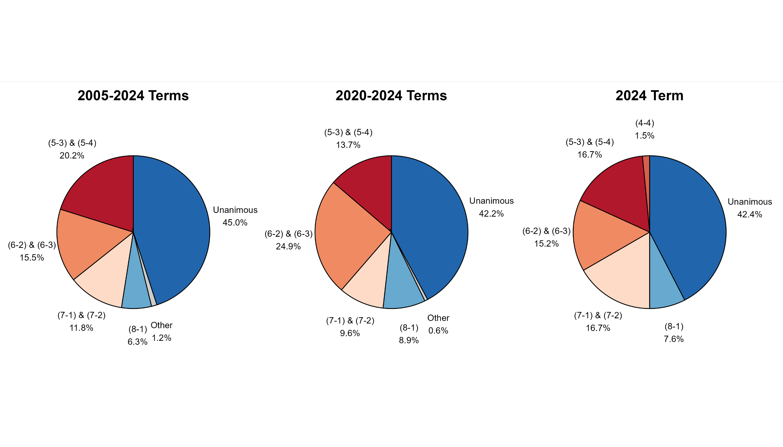
DECISIONS BY VOTE SPLIT – All Cases
Figures show the percent of cases decided by different coalition sizes between the 2005 and 2024 terms. For instances where justices were recused or did not participate in an otherwise unanimous decision, we coded these as unanimous (e.g., 8-0 decisions were included in calculating 9-0 coalitions).

Slide 16
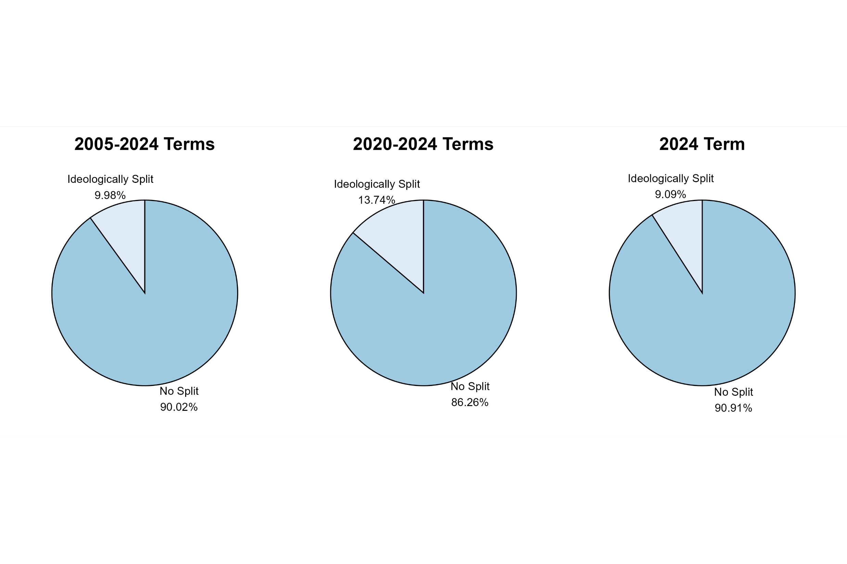
DECISIONS BY VOTE SPLIT– Ideologically Split Cases
Figures show the percent of cases decided by ideologically split coalitions (e.g., 5-4 or 6-3), such that ideologically liberal and conservative justices represent competing coalitions. Ideology was derived by referencing each justices’ associated Martin-Quinn score. For reference, such a split during the 2024 term would be a majority consisting of Chief Justice Roberts and Justices Thomas, Alito, Gorsuch, Kavanaugh, and Barrett – with a competing (dissenting) coalition of Justices Sotomayor, Kagan, and Jackson.

Slide 17
CIRCUIT SCORECARD
​Court below | # of Cases | # Decided | # Affirmed | # Reversed | % Affirmed | % Reversed
1st Circuit | 2 | 2 | 0 | 2 | 0% | 100%
2nd Circuit | 5 | 5 | 2 | 3 | 40% | 60%
3rd Circuit | 2 | 2 | 1 | 1 | 50% | 50%
4th ​Circuit | 8 | 8 | 0 | 8 | 0% | 100%
5th Circuit | 13 | 13 | 3 | 10 | 23.1% | 76.9%
6th Circuit | 4 | 4 | 2 | 2 | 50% | 50%
7th Circuit | 2 | 2 | 1 | 1 | 50% | 50%
8th Circuit​ | 2 | 2 | 1 | 1 | 50% | 50%
9th Circuit | 7* | 4 | 0 | 4 | 0% | 100%
10th Circuit | 5 | 5 | 0 | 5 | 0% | 100%
11th Circuit | 4 | 4 | 2 | 2 | 50% | 50%
D.C. Circuit | 5 | 5 | 2 | 3 | 40% | 60%
Fed. Circuit​ | 3 | 3 | 1 | 2 | 33.3% | 66.7%
​Total | 62 | 59 | 15 | 44
We treat consolidated cases emerging from the same lower court as single entries. Alternatively, we treat Trump v. CASA as three separate entries that reversed the U.S. Courts of Appeal for the First, Fourth, and Ninth Circuits.
* Three cases from the U.S. Court of Appeals for the Ninth Circuit were dismissed as improvidently granted and are not recorded as having been affirmed or reversed.

Slide 18
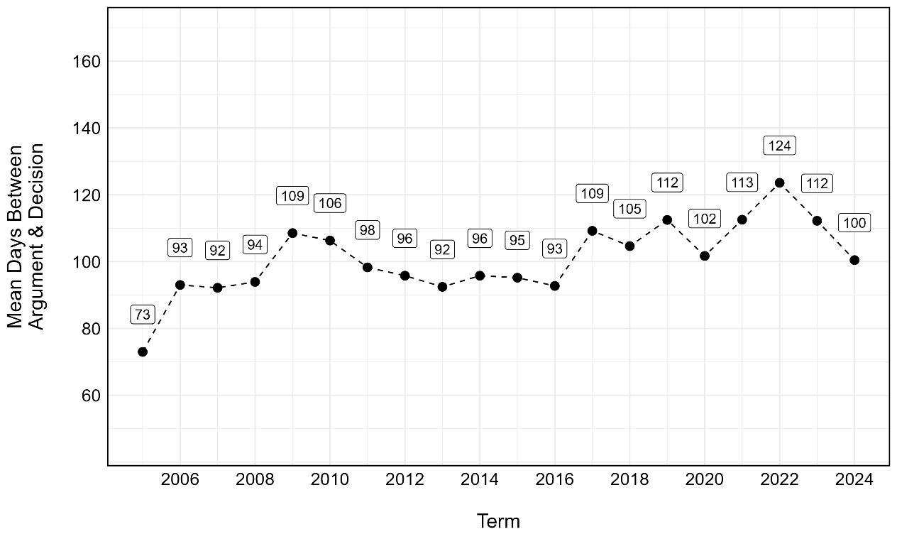
DAYS BETWEEN ARGUMENT & OPINION
Average Days by Justice
Roberts | 107.67
Thomas | 106.86
Alito | 93.83
Sotomayor | 91.67
Kagan | 98.5
Gorsuch | 127.5
Kavanaugh | 109.29
Barrett | 124.86
Jackson | 102.2
Average Days by Term
Figure shows the average number of days between oral arguments and the rendering of a decision for a case between the 2005 and 2024 terms.
 | Rank | Case | Days | Author | Vote | Argued | Decided
Shortest | 1 | TikTok | 8 | PC | 9-0 | 01/10/2025 | 01/17/2025
 | 2 | Facebook | 17 | PC | PC | 11/06/2024 | 11/22/2024
 | 3 | Drummond | 23 | PC | 4-4 | 04/30/2025 | 05/22/2025
 | 4 | NVIDIA | 29 | PC | PC | 11/13/2024 | 12/11/2024
 | 5 | Laboratory Corp | 38 | PC | 9-0 | 04/29/2025 | 06/05/2025
Longest
 | 1 | Skrmetti | 197 | Roberts | 6-3 | 12/04/2024 | 06/18/2025
 | 2 | Advocate Christ Medical | 176 | Barrett | 7-2 | 11/05/2024 | 04/29/2025
 | 3 | Seven County | 171 | Kavanaugh | 8-0 | 12/10/2024 | 05/29/2025
 | 4 | Vanderstok | 170 | Gorsuch | 7-2 | 10/08/2024 | 03/26/2025
 | 5 | Medical Marijuana | 170 | Barrett | 5-4 | 10/15/2024 | 04/02/2025

Slide 19
OPINIONS AUTHORED BY EACH JUSTICE
 |  | Roberts | Thomas | Alito | Sotomayor | Kagan | Gorsuch | Kavanaugh | Barrett | Jackson | Total
Majority | 1 | Lackey | Bufkin | Waetzig | Hungary | Royal Canin | Vanderstok | E.M.D. Sales | Medical Marijuana | Bouarfa
 | 2 | Thompson | Delligatti | SF v. EPA | Glossip | Wisconsin Bell | Velazquez | Williams | Advocate Christ Medical | Miller
 | 3 | A.J.T. | BLOM Bank | Wages and White Lion | Cunningham | Dewberry | Feliciano | Seven County | Kousisis | Ames
 | 4 | Perttu | Soto | CC/Devas | Catholic Charities | Barnes | Martin | NRC | Zuch | Rivers
 | 5 | Skrmetti | Oklahoma | Riley | Parrish | Smith and Wesson | Stanley | Diamond | Esteras | Hewitt
Concurring | 1 |  | Wisconsin Bell | Andrew | TikTok |  | E.M.D. Sales | Wisconsin Bell | Skrmetti | Thompson
 | 2 |  | Kousisis | Thompson | Dewberry |  | TikTok | Vanderstok | Gutierrez | Vanderstok
 | 3 |  | Ames | Cunningham | Vanderstok |  | Kousisis | Trump v. J.G.G. |  | Medical Marijuana
 | 4 |  | Smith and Wesson | Skrmetti | Wages and White Lion |  | Oklahoma | Barnes |  | Smith and Wesson
 | 5 |  | Catholic Charities | Trump v. CASA | Kousisis |  |  | A.A.R.P v. Trump |  | Catholic Charities
 | 6 |  | A.J.T. |  | Seven County |  |  | Trump v. CASA |  | BLOM Bank
 | 7 |  | Skrmetti |  | A.J.T. |  |  | Consumers’ Research |  | Parrish
Dissenting | 1 |  | Andrew | Vanderstok | Trump v. J.G.G. | DOE v. CA | Delligatti | Medical Marijuana | Glossip | Lackey
 | 2 |  | Williams | Velazquez | Skrmetti | Skrmetti | Miller | Laboratory Corp. | SF v. EPA | Bufkin
 | 3 |  | Glossip | A.A.R.P v. Trump | Diamond | McLaughlin | Parrish |  | Velazquez | DOE v. CA
 | 4 |  | Vanderstok | Esteras | Riley | Free Speech | Zuch |  | Perttu | Trump v. J.G.G.
 | 5 |  | Medical Marijuana | Hewitt | Trump v. CASA |  | Calumet |  |  | Advocate Christ Medical
 | 6 |  | Velazquez | Gutierrez | Mahmoud |  | NRC |  |  | Stanley
 | 7 |  | Feliciano |  |  |  | Consumers’ Research |  |  | Diamond

Slide 20
OPINIONS AUTHORED BY EACH JUSTICE (Cont.)
 |  | Roberts | Thomas | Alito | Sotomayor | Kagan | Gorsuch | Kavanaugh | Barrett | Jackson | Total
Majority | 1 | Fuld | Calumet | Mahmoud | Gutierrez | Consumers’ Research | Medina | McLaughlin | R.J. Reynolds
 | 2 |  | Free Speech |  |  |  |  | Kennedy | Trump v. CASA
 | 3
 | 4
 | 5
Concurring | 1 |  | Fuld |  | Martin |  |  |  |  | Esteras
 | 2 |  | Stanley |  | Stanley |  |  |  |  | Consumers’ Research
 | 3 |  | Medina |  | Esteras
 | 4 |  | Riley
 | 5 |  | Trump v. CASA
 | 6 |  | Mahmoud
 | 7
Dissenting | 1 |  | Gutierrez |  |  |  |  |  |  | R.J. Reynolds
 | 2 |  | Kennedy |  |  |  |  |  |  | Medina
 | 3 |  |  |  |  |  |  |  |  | Trump v. CASA
 | 4
 | 5
 | 6
 | 7

Slide 21
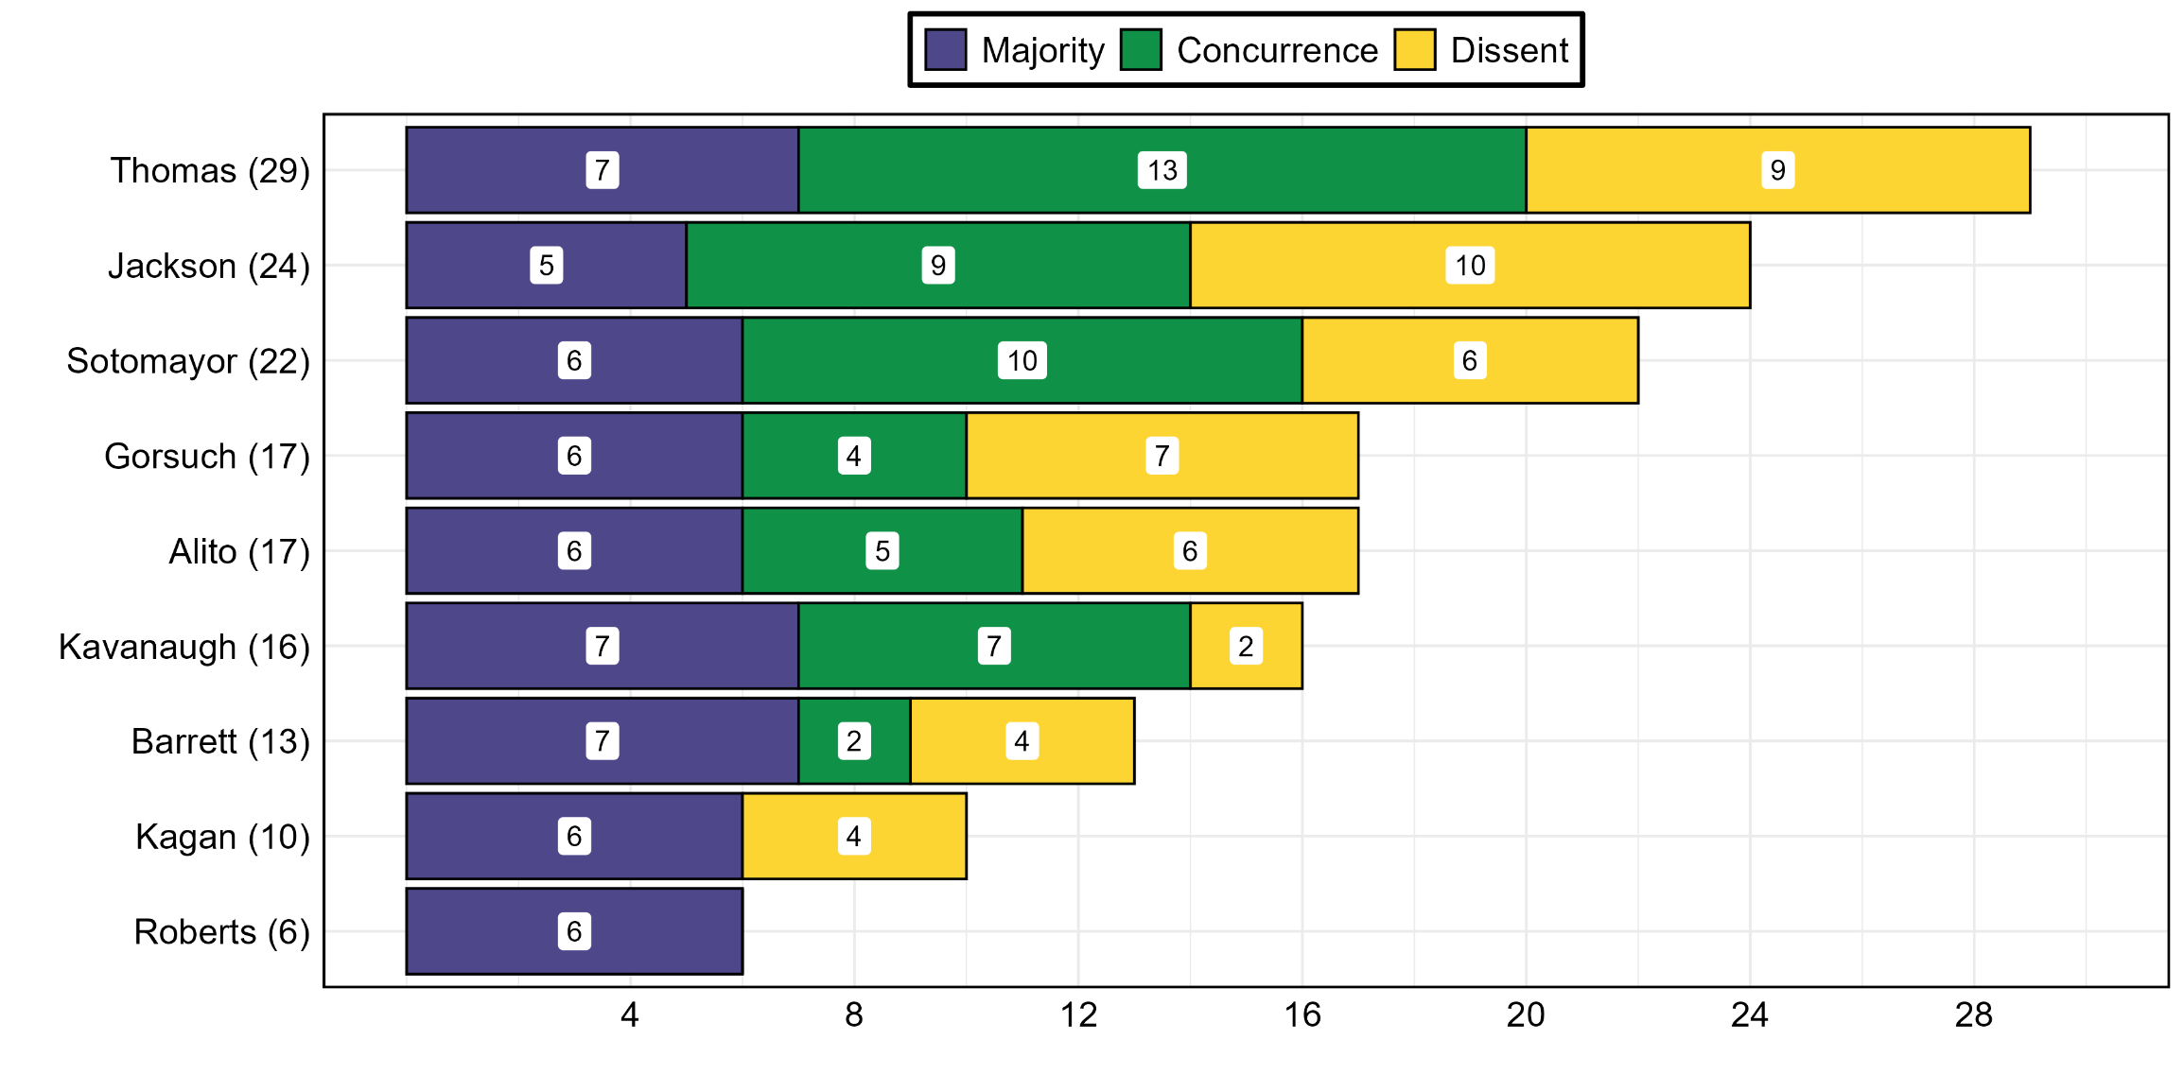
OPINIONS AUTHORED BY EACH JUSTICE (Cont.)
Figure shows the volume & proportion of opinions (by type) authored by each justice during the 2024 term. Special concurrences (in part) and those concurring in judgment are similarly coded as concurrences.

Slide 22
OPINION LENGTHS
 | Rank | Case | Opinion Type | Author | Vote | Word Count | Decided
Shortest (Individual Opinions) | 1 | NVIDIA | PC | PC | PC | 13 | 12/11/2024
 | 2 | Facebook | PC | PC | PC | 13 | 11/22/2024
 | 3 | Laboratory Corp. | PC | PC | PC (8-1) | 13 | 6/5/2025
 | 4 | Drummond | PC | PC | 4-4 | 22 | 5/22/2025
 | 5 | Oklahoma | Concurrence | Gorsuch | 8-0 | 81 | 06/18/2025
Longest (Individual Opinions)
 | 1 | Glossip | Dissent | Thomas | 5-3 | ≈14,200 | 2/25/2025
 | 2 | Wages and White Lion | Majority | Alito | 9-0 | ≈14,100 | 4/2/2025
 | 3 | Trump v. CASA | Dissent | Sotomayor | 6-3 | ≈13,800 | 06/27/2025
 | 4 | Kennedy | Majority | Kavanaugh | 6-3 | ≈12,100 | 06/27/2025
 | 5 | Mahmoud | Majority | Alito | 6-3 | ≈11,900 | 06/27/2025
Longest (Total Combined) | Rank | Case | No. Opinions | Authors | Vote | Total Words | Decided
 | 1 | Trump v. CASA | 6 | Alito; Barrett; Jackson; Kavanaugh; Sotomayor; Thomas | 6-3 | ≈35,200 | 6/27/2025
 | 2 | Skrmetti | 6 | Alito; Barrett; Kagan; Roberts; Sotomayor; Thomas | 6-3 | ≈30,400 | 6/18/2025
 | 3 | Mahmoud | 3 | Alito; Sotomayor; Thomas | 6-3 | ≈26,000 | 6/27/2025
 | 4 | Glossip | 3 | Barrett; Sotomayor; Thomas | 5-3 | ≈25,000 | 2/25/2025
 | 5 | Consumers’ Research | 4 | Gorsuch; Jackson; Kagan; Kavanaugh | 6-3 | ≈24,000 | 6/27/2025

Slide 23
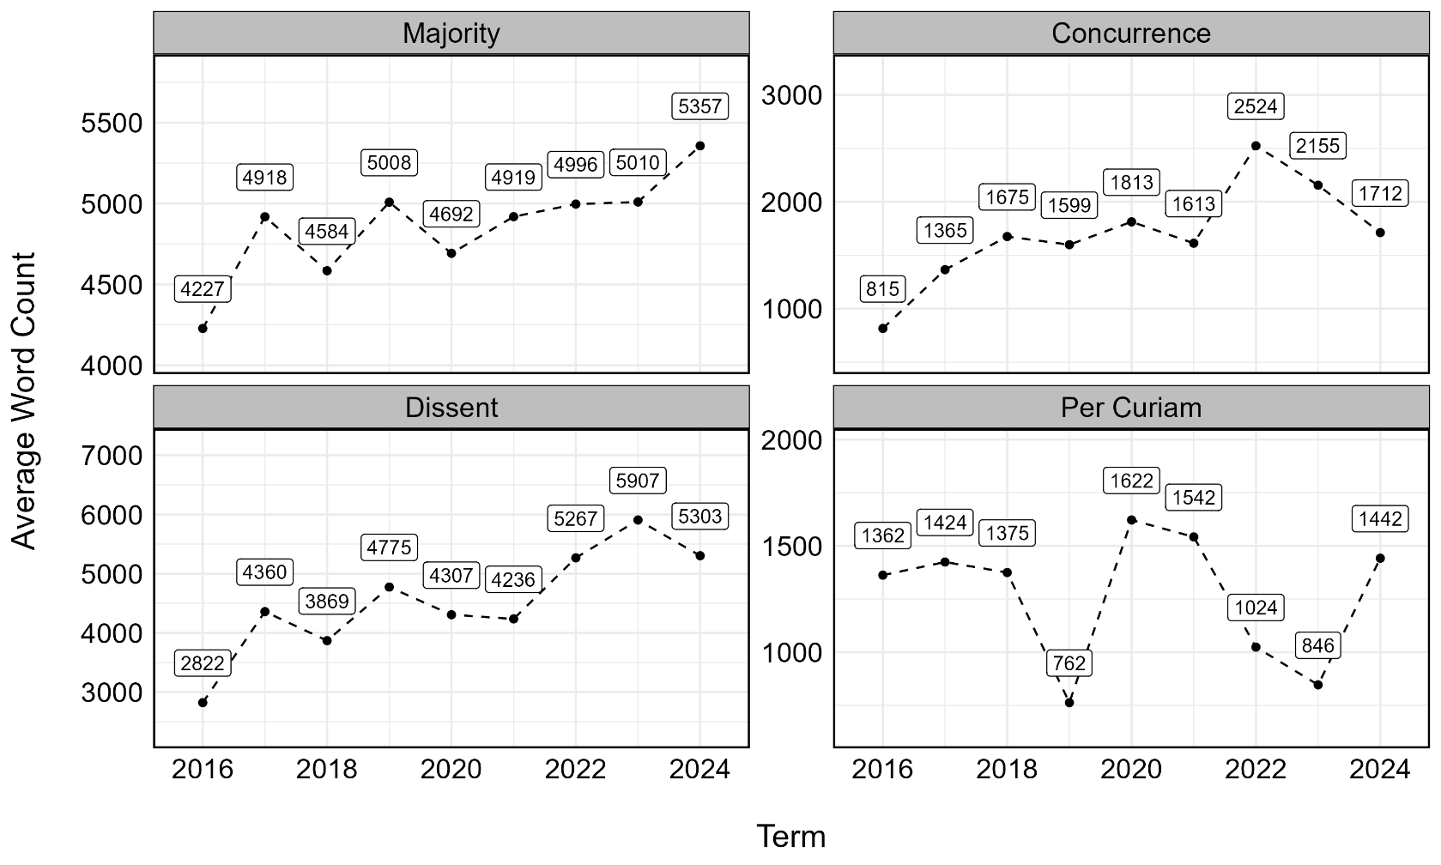
OPINION LENGTHS (Cont.)
Average Opinion Length by Justice
Roberts | ≈4,700
Thomas | ≈4,700
Alito | ≈4,700
Sotomayor | ≈4,100
Kagan | ≈4,300
Gorsuch | ≈4,300
Kavanaugh | ≈3,900
Barrett | ≈3,800
Jackson | ≈3,400
Figure shows the average length (in words) of opinions issued by the court by type between the 2016 and 2024 terms.

Slide 24
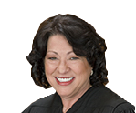
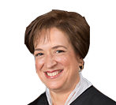
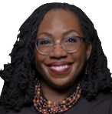
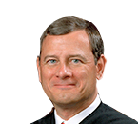
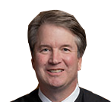
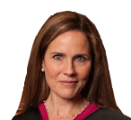
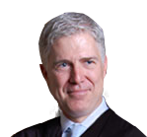
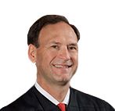
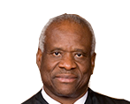
VOTING ALIGNMENT
Joined Majority Joined Dissent Authored Special (In Part) Did Not Participate Concurrence (or In judgment)
Case Name | Decided | Vote | Author
Hamm | 11/4/2024 | (9-0)* | Per Curiam
Facebook | 11/22/2024 | Per Curiam | Per Curiam
Bouarfa | 12/10/2024 | (9-0) | Jackson
NVIDIA | 12/11/2024 | Per Curiam | Per Curiam
Royal Canin | 1/15/2025 | (9-0) | Kagan
E.M.D. Sales | 1/15/2025 | (9-0) | Kavanaugh
Tik Tok | 1/17/2025 | (9-0) | Per Curiam
Andrew | 1/21/2025 | (7-2) | Per Curiam
Hungary | 2/21/2025 | (9-0) | Sotomayor
Wisconsin Bell | 2/21/2025 | (9-0) | Kagan
Williams | 2/21/2025 | (5-4) | Kavanaugh
Lackey | 2/25/2025 | (7-2) | Roberts
Glossip | 2/25/2025 | (5-3)** | Sotomayor
Waetzig | 2/26/2025 | (9-0) | Alito
Dewberry | 2/26/2025 | (9-0) | Kagan
* Justices Thomas and Gorsuch would vote to grant the petition and set the case for argument.
** Justice Barrett joined the majority but only with respect to Part II, authored a separate opinion concurring (in part) and dissenting (in part), and joined Justice Thomas’ dissent with respect to Parts IV-A-1, IV-A-2, and IV-A-3.

Slide 25
VOTING ALIGNMENT
Joined Majority Joined Dissent Authored Special (In Part) Did Not Participate Concurrence (or In judgment)
Case Name | Decided | Vote | Author
SF v. EPA* | 3/4/2025 | (5-4) | Alito
Bufkin | 3/5/2025 | (7-2) | Thomas
Thompson | 3/21/2025 | (9-0) | Roberts
Delligatti | 3/21/2025 | (7-2) | Thomas
Vanderstok | 3/26/2025 | (7-2) | Gorsuch
Miller | 3/26/2025 | (8-1) | Jackson
Wages & White Lion | 4/2/2025 | (9-0) | Alito
Medical Marijuana | 4/2/2025 | (5-4) | Barrett
D.O.E. v. CA | 4/4/2025 | (5-4)* | Per Curiam
Trump v. J.G.G. | 4/7/2025 | (5-4)** | Per Curiam
Cunningham | 4/17/2025 | (9-0) | Sotomayor
Velazquez | 4/22/2025 | (5-4) | Gorsuch
Advocate Christ Medical | 04/29/2025 | (7-2) | Barrett
Feliciano | 04/30/2025 | (5-4) | Gorsuch
Barnes | 05/15/2025 | (9-0) | Kagan
* Chief Justice Roberts would have voted to deny the application. ** Justice Barrett authored an opinion dissenting (in part) – this opinion is coded as a dissent since there was no additional concurrence (in part).

Slide 26
VOTING ALIGNMENT
Joined Majority Joined Dissent Authored Special (In Part) Did Not Participate Concurrence (or In judgment)
Case Name | Decided | Vote | Author
A.A.R.P. v. Trump | 05/16/2025 | (7-2) | Per Curiam
Kousisis | 05/22/2025 | (9-0) | Barrett
Drummond | 05/22/2025 | (4-4)* | Per Curiam
Seven County | 05/29/2025 | (8-0) | Kavanaugh
Laboratory Corp | 06/05/2025 | DIG (8-1) | Per Curiam
Ames | 06/05/2025 | (9-0) | Jackson
Smith & Wesson | 06/05/2025 | (9-0) | Kagan
Catholic Charities | 06/05/2025 | (9-0) | Sotomayor
CC/Devas | 06/05/2025 | (9-0) | Alito
Blom Bank | 06/05/2025 | (9-0) | Thomas
A.J.T. | 06/12/2025 | (9-0) | Roberts
Soto | 06/12/2025 | (9-0) | Thomas
Parrish | 06/12/2025 | (8-1) | Sotomayor
Martin | 06/12/2025 | (9-0) | Gorsuch
Zuch | 06/12/2025 | (8-1) | Barrett
* Oklahoma Charter Schools v. Drummond was decided per curiam by an equally divided court (Justice Barrett did not participate). However, the opinion did not indicate who voted to affirm (reverse).

Slide 27
VOTING ALIGNMENT
Joined Majority Joined Dissent Authored Special (In Part) Did Not Participate Concurrence (or In judgment)
Case Name | Decided | Vote | Author
Rivers | 06/12/2025 | (9-0) | Jackson
Perttu | 06/18/2025 | (5-4) | Roberts
Skrmetti | 06/18/2025 | (6-3) | Roberts
Oklahoma | 06/18/2025 | (8-0) | Thomas
Calumet | 06/18/2025 | (7-2) | Thomas
NRC | 06/18/2025 | (6-3) | Kavanaugh
Fuld | 06/20/2025 | (9-0) | Roberts
Stanley | 06/20/2025 | (8-1)* | Gorsuch
Diamond | 06/20/2025 | (7-2) | Kavanaugh
McLaughlin | 06/20/2025 | (6-3) | Kavanaugh
Esteras | 06/20/2025 | (7-2) | Barrett
R.J. Reynolds | 06/20/2025 | (7-2) | Barrett
Hewitt | 06/26/2025 | (5-4) | Jackson
Medina | 06/26/2025 | (6-3) | Gorsuch
Gutierrez | 06/26/2025 | (6-3) | Sotomayor
* Stanley represents a particularly fractured opinion with varying authors and coalitions forming across distinct parts. Given that Justice Jackson is the only justice to dissent in full, the decision is coded as (8-1). Furthermore, although Justice Sotomayor joined Justice Jackson’s dissent with respect to elements of Parts III and IV, she joined with the plurality of the court in not reversing the 11th Circuit.

Slide 28
VOTING ALIGNMENT
Joined Majority Joined Dissent Authored Special (In Part) Did Not Participate Concurrence (or In judgment)
Case Name | Decided | Vote | Author
Riley | 06/26/2025 | 5-4 | Alito
Trump v. CASA | 06/27/2025 | 6-3 | Barrett
Kennedy | 06/27/2025 | 6-3 | Kavanaugh
Consumers’ Research | 06/27/2025 | 6-3 | Kagan
Mahmoud | 06/27/2025 | 6-3 | Alito
Free Speech | 06/27/2025 | 6-3 | Thomas

Slide 29
TERM INDEX
This Chart Includes Information re: Case Name, Majority Opinion Author, Vote, Days Between Arguments and Opinion, judgment, and Court Below
A = Affirmed V = Vacated R = Reversed G = Granted DIG = Dismissed as Improvidently Granted PC = Per Curiam
October​ Sitting |  |  |  |  |  | November​ Sitting |  |  |  |  |  | December Sitting​
Williams | Kavanaugh | 5-4 | 138d | R | SCAL | Wisconsin Bell | Kagan | 9-0 | 110d | A | CA7 | Wages & White Lion | Alito | 9-0 |  | 122d | V | CA5
Royal Canin | Kagan | 9-0 | 101d | A | CA8 | Advocate Christ Medical | Barrett | 7-2 | 176d | A | CADC | Miller | Jackson | 8-1 |  | 115d | R | CA10
Vanderstok | Gorsuch | 7-2 | 170d | R | CA5 | E.M.D. Sales | Kavanaugh | 9-0 | 72d | R | CA4 | Hungary | Sotomayor | 9-0 |  | 81d | V | CADC
Lackey | Roberts | 7-2 | 141d | R | CA4 | Facebook | PC | PC | 17d | DIG | CA9 | Skrmetti | Roberts | 6-3 |  | 197d | A | CA6
Glossip | Sotomayor | 5-3 | 140d | R | CCAOK | Velazquez | Gorsuch | 5-4 | 162d | R | CA10 | Kousisis | Barrett | 9-0 |  | 164d | A | CA3
Medical Marijuana | Barrett | 5-4 | 170d | A | CA2 | Delligatti | Thomas | 7-2 | 130d | A | CA2 | Feliciano | Gorsuch | 5-4 |  | 143d | R | CAFED
Bouarfa | Jackson | 9-0 | 57d | A | CA11 | NVIDIA | PC | PC | 29d | DIG | CA9 | Seven County | Kavanaugh | 8-0 |  | 171d | R | CADC
Bufkin | Thomas | 7-2 | 141d | A | CAFED |  |  |  |  |  |  | Dewberry | Kagan | 9-0 |  | 78d | V | CA4
SF v. EPA | Alito | 5-4 | 140d | R | CA9
January​ Sitting |  |  |  |  |  | February Sitting |  |  |  |  |  | March Sitting
Hewitt | Jackson | 5-4 | 165d | R | CA5 | Gutierrez | Sotomayor | 6-3 | 123d | R | CA5 | Louisiana | Slated for reargument |  |  |  |  | WDLA
Stanley | Gorsuch | 8-1 | 159d | A | CA11 | Esteras | Barrett | 7-2 | 116d | V | CA6 | Riley | Alito | 5-4 |  | 95d | V | CA4
Thompson | Roberts | 9-0 | 67d | V | CA7 | Perttu | Roberts | 5-4 | 114d | A | CA6 | Calumet | Thomas | 7-2 |  | 86d | V | CA5
Waetzig | Alito | 9-0 | 44d | R | CA10 | Ames | Jackson | 9-0 | 100d | V | CA6 | Oklahoma | Thomas | 8-0 |  | 86d | R | CA10
Free Speech | Thomas | 6-3 | 164d | A | CA5 | CC/Devas | Alito | 9-0 | 95d | R | CA9 | Consumers’ Research | Kagan | 6-3 |  | 94d | R | CA5
R.J. Reynolds | Barrett | 7-2 | 151d | A | CA5 | BLOM Bank | Thomas | 9-0 | 95d | R | CA2 | Catholic Charities | Sotomayor | 9-0 |  | 67d | R | SCWI
McLaughlin | Kavanaugh | 6-3 | 151d | R | CA9 | Smith & Wesson | Kagan | 9-0 | 94d | R | CA1 | Rivers | Jackson | 9-0 |  | 74d | A | CA5
Barnes | Kagan | 9-0 | 114d | V | CA5 | NRC | Kavanaugh | 6-3 | 94d | R | CA5 | Fuld | Roberts | 9-0 |  | 81d | R | CA2
Cunningham | Sotomayor | 9-0 | 86d | R | CA2 |  |  |  |  |  |  | Medina | Gorsuch | 6-3 |  | 86d | R | CA4
TikTok | PC | PC | 8d | A | CADC
April-May Sittings |  |  |  |  |  | No Argument |  |  |  |  |  | Totals
Kennedy | Kavanaugh | 6-3 | 68d | R | CA5 | Hamm | PC | 9-0 |  | V | CA11 | Opinions of the Court – Signed |  | +34 | 56
Parrish | Sotomayor | 8-1 | 53d | R | CA4 | Andrew | PC | 7-2 |  | V | CA10 | Opinions of the Court – Per Curiam |  | +2 | 10
Mahmoud | Alito | 6-3 | 67d | R | CA4 | DOE v. CA | PC | 5-4 |  | G | DCMA |  |  | +7 | 66 | Total opinions released
Zuch | Barrett | 8-1 | 52d | R | CA3 | Trump v. J.G.G. | PC | 5-4 |  | V | DCDC |  |  | 43
Diamond | Kavanaugh | 7-2 | 59d | R | CADC | A.A.R.P. v. Trump | PC | 7-2 |  | V | CA5 | Cases Granted for Argument |  | +62 | 62
A.J.T. | Roberts | 9-0 | 46d | V | CA8 |  |  |  |  |  |  | Cases Decided Without Argument |  | +7 | 5
Soto | Thomas | 9-0 | 46d | R | CAFED |  |  |  |  |  |  | Cases Postponed Before Argument |  | -4 | 0
Martin | Gorsuch | 9-0 | 45d | V | CA11 |  |  |  |  |  |  | Cases Dismissed After Argument |  | -1 | 4
Laboratory Corp. | PC | 8-1 | 38d | DIG | CA9 |  |  |  |  |  |  |  |  | -1 | 67 | Total opinions expected
Drummond | PC | 4-4 | 22d | A | SCOK |  |  |  |  |  |  |  |  | 64
Trump v. CASA | Barrett | 6-3 | 44d | V | CA4

